Slide 1
Project IAC
Road to Version 1.1
Matias Lippai

Slide 2
Topics
Project Requirements
V1.0 Diagram
V1.1 Diagram
Deployment Order
Challenges
Live Demo

Slide 3
V1.1 Main requirements
Load balancing solution
Http to Https redirect
TLS 1.2 implementation
Automatic server repair triggered by health checks
Automatic scaling out and in

Slide 4
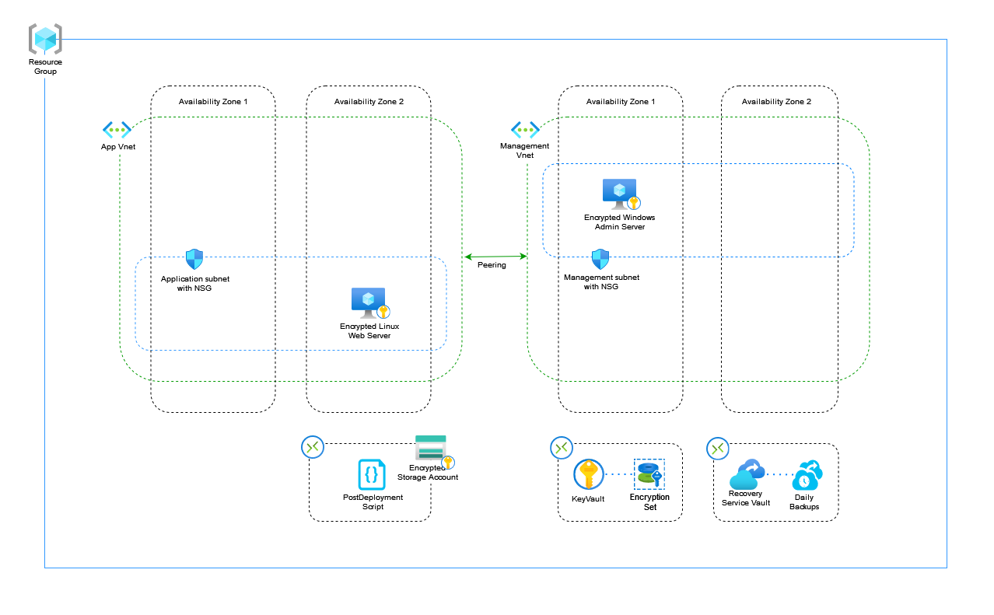
V1.0 Diagram

Slide 5
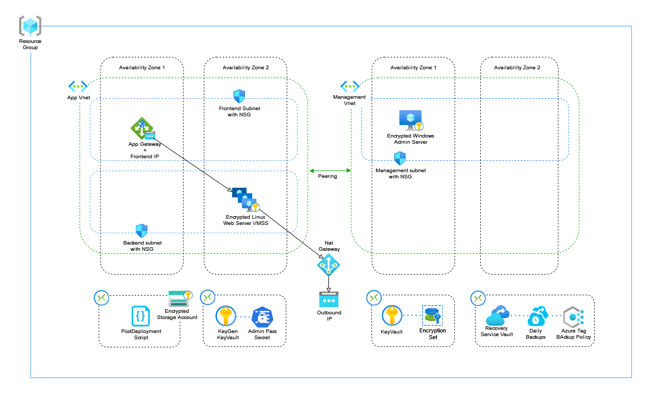
V1.1 Diagram

Slide 6
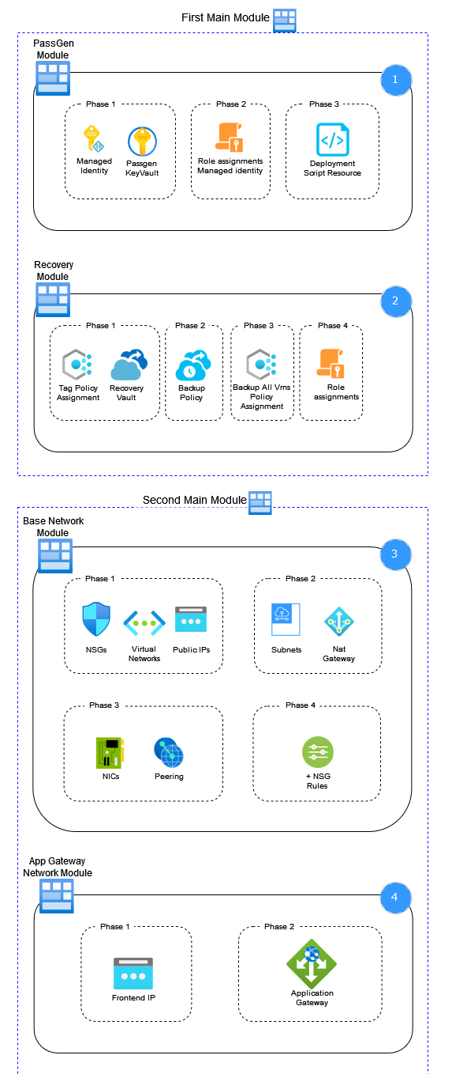
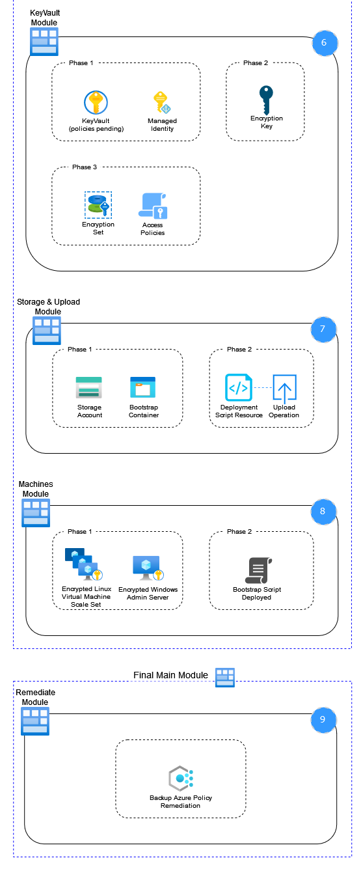
Deployment order
Initial main module
Password generation module
Recovery module
Second main module
Network modules
Vault module
Machine module
Final main module
Remediation module

Slide 7
Challenges
Backing up VMSS machines
Solution: using policies to backup vms created by VMSS
Circular dependencies
Solution: split resources declarations into parent/child and nested modules
Complete automation
Password generation and storage
Simplification of parameter entry
.ps1 deployment file

Slide 8
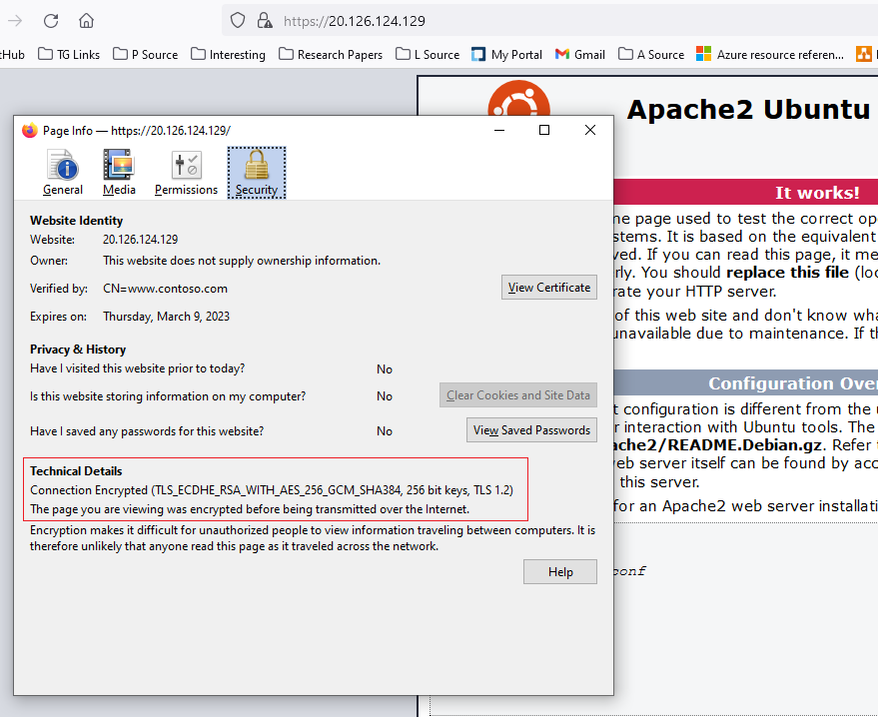
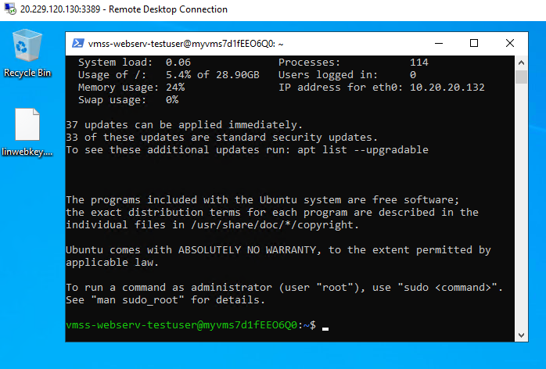
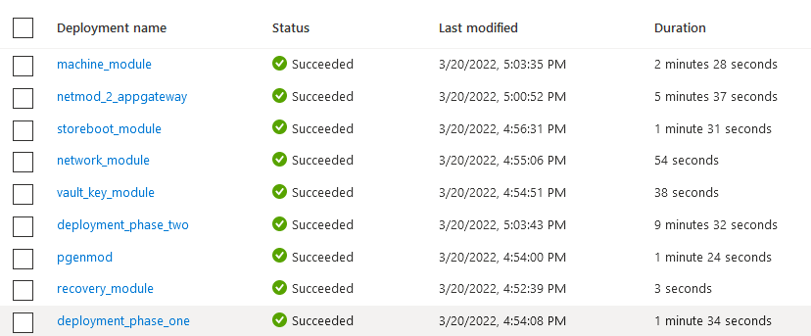
Live Demo
IAC
Deployment
Portal live resource post deployment
Requirement testing

Slide 9
Questions?

